Slide 1
Work, Kinetic Energy, and Potential Energy for Rigid Body Systems
Dr. Jacob Moore
Associate Professor of Engineering
Penn State Mont Alto

Slide 2
Work and Energy Kinetics
The work energy method in kinetics is best summarized as this...
“The work done to a system will be equal to the change in the system’s energy”
Work is...
A force applied over a distance
A moment applied of an angle of twist
Energy is...
Translational or Rotational Kinetic Energy
Gravitational or Elastic Potential Energy (a replacement for work done by gravity forces or work done by elastic / spring forces)

Slide 3
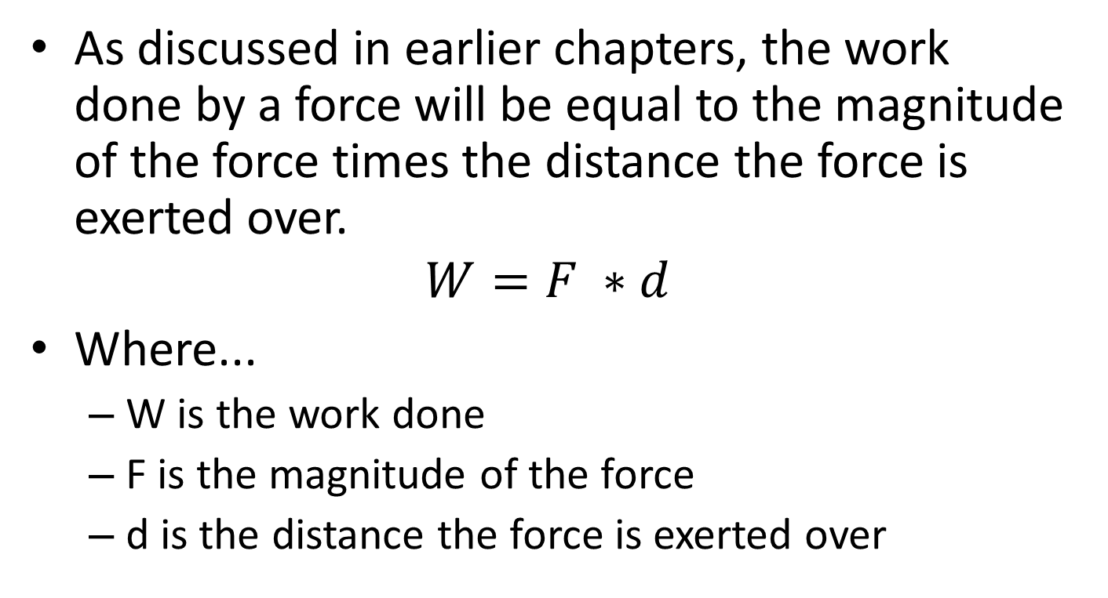
Work of a Force
As discussed in earlier chapters, the work done by a force will be equal to the magnitude of the force times the distance the force is exerted over.
$$W=F ∗d$$
Where...
W is the work done
F is the magnitude of the force
d is the distance the force is exerted over

Slide 4
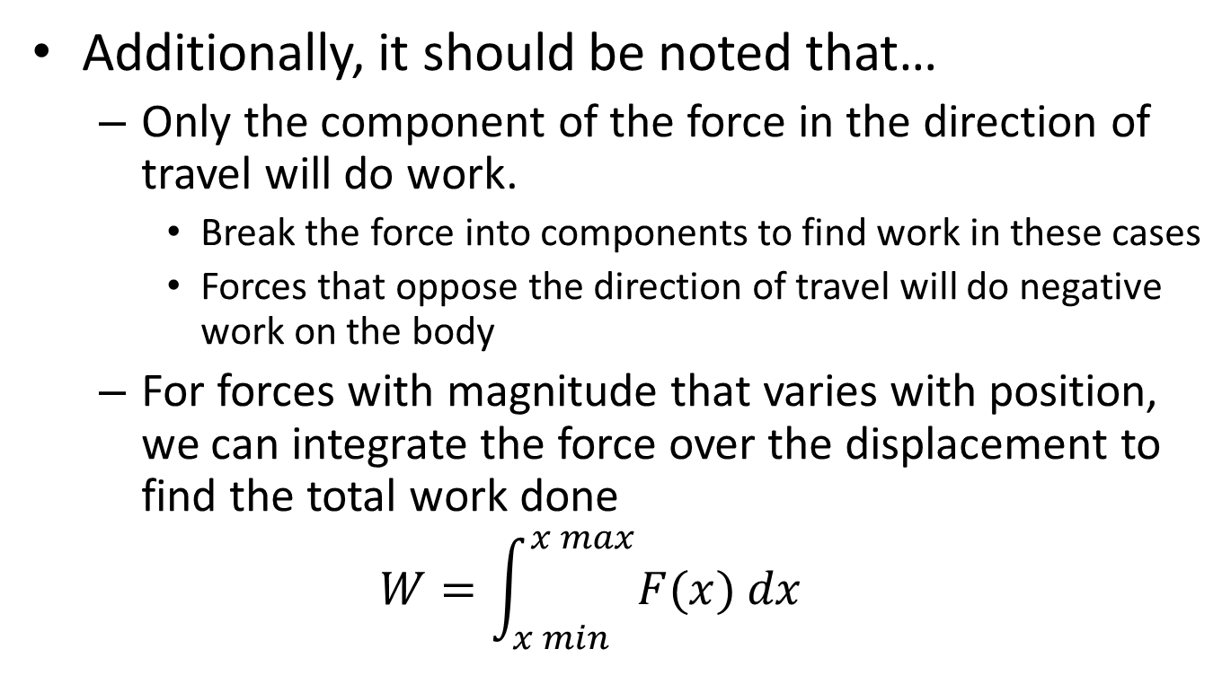
Work of a Force
Additionally, it should be noted that…
Only the component of the force in the direction of travel will do work.
Break the force into components to find work in these cases
Forces that oppose the direction of travel will do negative work on the body
For forces with magnitude that varies with position, we can integrate the force over the displacement to find the total work done
$$W=\int_{x min}^{x max}{F(x) dx}$$

Slide 5
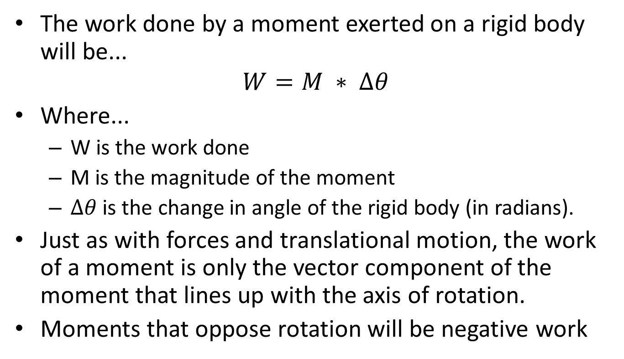
Work of a Moment
The work done by a moment exerted on a rigid body will be...
$$W=M ∗ ∆θ$$
Where...
W is the work done
M is the magnitude of the moment
$∆θ$ is the change in angle of the rigid body (in radians).
Just as with forces and translational motion, the work of a moment is only the vector component of the moment that lines up with the axis of rotation.
Moments that oppose rotation will be negative work

Slide 6
Work of a Moment
Also as with forces, if the moment varies with position, you can integrate the moment over the angle of displacement to find the overall moment.
$$W=\int_{θ min}^{θ max}{M(θ) dθ}$$
$$M$$
M$\left(θ\right)= …$
$$θ$$

Slide 7
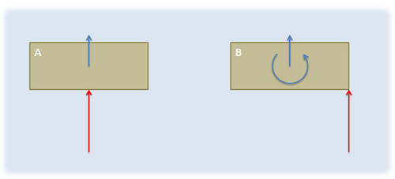
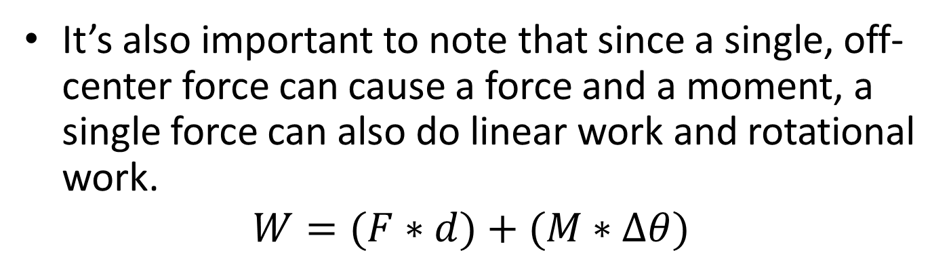
Work in Rigid Body Systems
It’s also important to note that since a single, off-center force can cause a force and a moment, a single force can also do linear work and rotational work.
$$W=(F∗d)+(M∗∆θ)$$

Slide 8
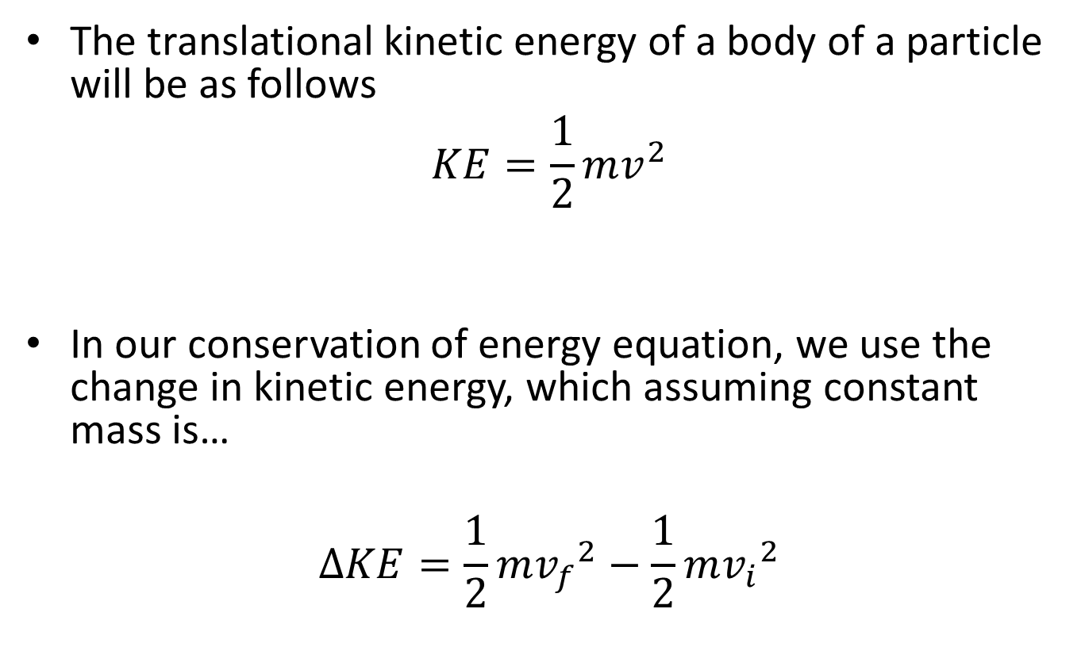
Translational Kinetic Energy
The translational kinetic energy of a body of a particle will be as follows
$$KE=\frac{1}{2}mv^{2}$$
In our conservation of energy equation, we use the change in kinetic energy, which assuming constant mass is…
$$∆KE=\frac{1}{2}m{v_{f}}^{2}−\frac{1}{2}m{v_{i}}^{2}$$
speed of object
mass of object

Slide 9

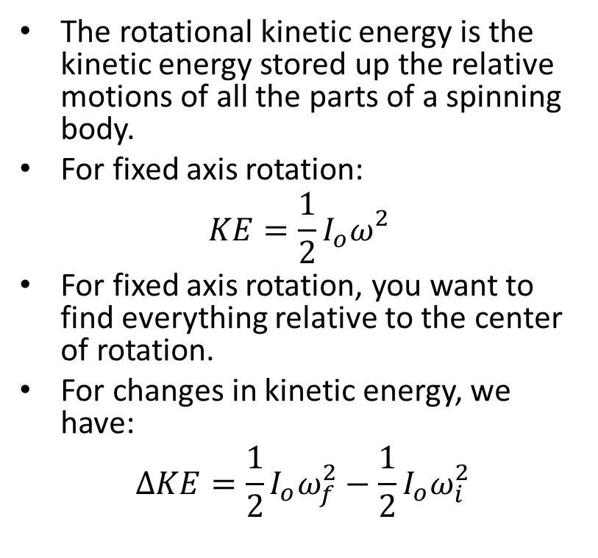
Rotational Kinetic Energy
The rotational kinetic energy is the kinetic energy stored up the relative motions of all the parts of a spinning body.
For fixed axis rotation:
$$KE=\frac{1}{2}I_{o}ω_{}^{2}$$
For fixed axis rotation, you want to find everything relative to the center of rotation.
For changes in kinetic energy, we have:
$$∆KE=\frac{1}{2}I_{o}ω_{f}^{2}−\frac{1}{2}I_{o}ω_{i}^{2}$$
$$ω$$
Center of Rotation (O)

Slide 10
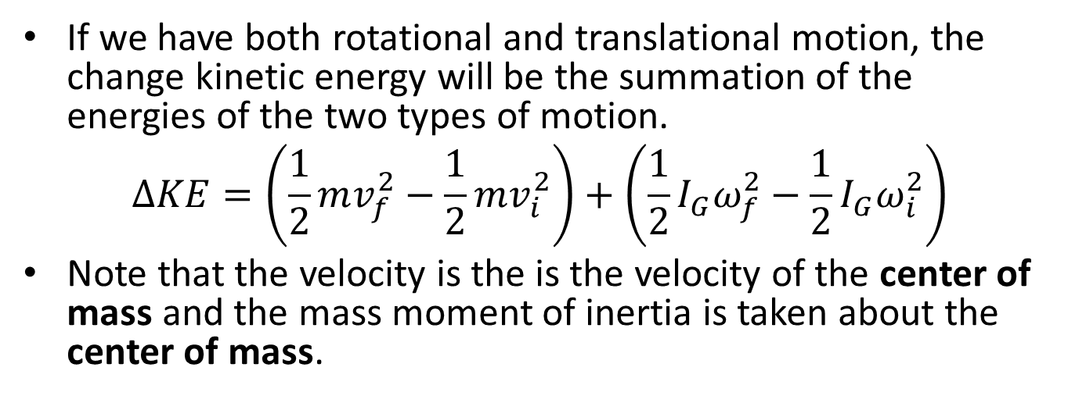
Kinetic Energy for General Planar Motion (Rotation and Translation)
If we have both rotational and translational motion, the change kinetic energy will be the summation of the energies of the two types of motion.
$$∆KE=\left(\frac{1}{2}mv_{f}^{2}−\frac{1}{2}mv_{i}^{2}\right)+\left(\frac{1}{2}I_{G}ω_{f}^{2}−\frac{1}{2}I_{G}ω_{i}^{2}\right)$$
Note that the velocity is the is the velocity of the center of mass and the mass moment of inertia is taken about the center of mass.
$$ω$$
$$v$$

Slide 11
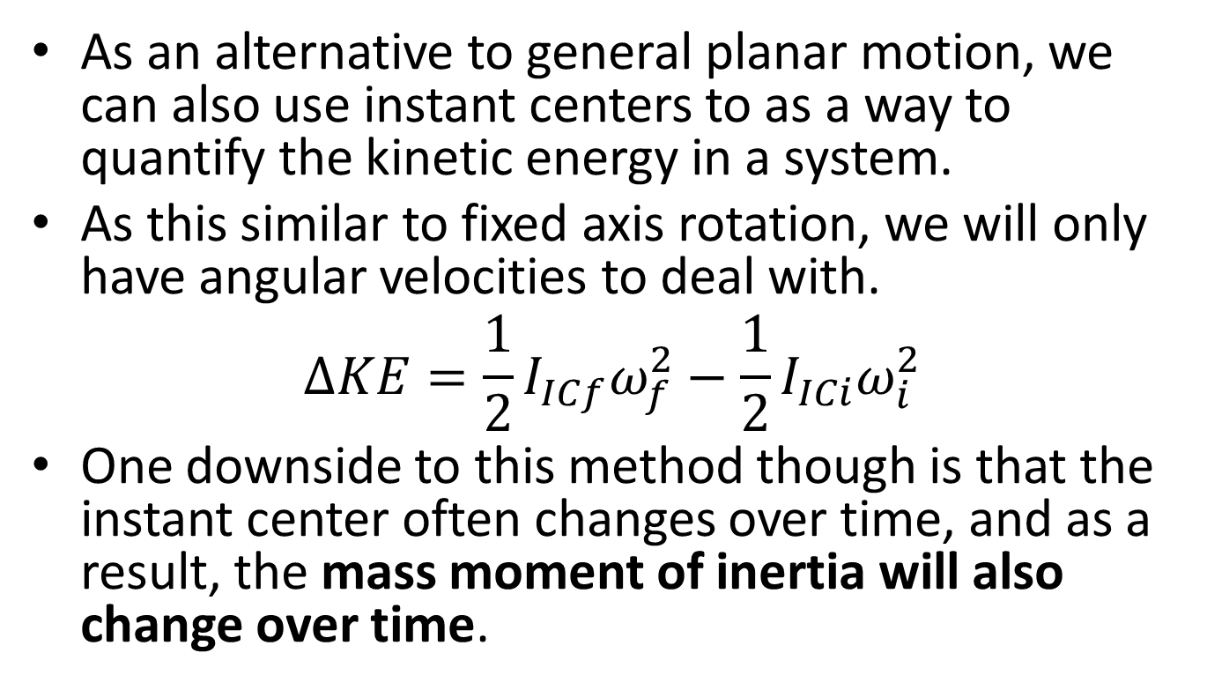
Kinetic Energy and Instant Centers
As an alternative to general planar motion, we can also use instant centers to as a way to quantify the kinetic energy in a system.
As this similar to fixed axis rotation, we will only have angular velocities to deal with.
$$∆KE=\frac{1}{2}I_{ICf}ω_{f}^{2}−\frac{1}{2}I_{ICi}ω_{i}^{2}$$
One downside to this method though is that the instant center often changes over time, and as a result, the mass moment of inertia will also change over time.

Slide 12

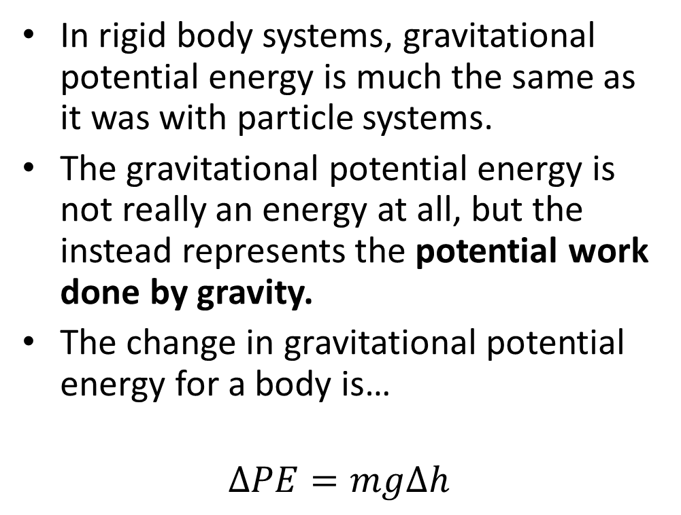

Gravitational Potential Energy
In rigid body systems, gravitational potential energy is much the same as it was with particle systems.
The gravitational potential energy is not really an energy at all, but the instead represents the potential work done by gravity.
The change in gravitational potential energy for a body is…
$$∆PE=mg∆h$$
$$F_{g}=mg$$
$$∆h$$

Slide 13
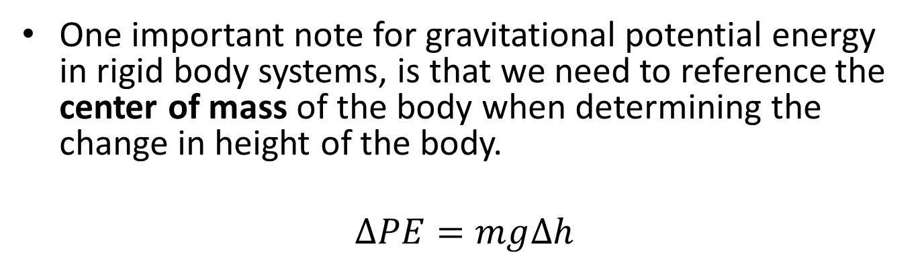
Gravitational Potential Energy
One important note for gravitational potential energy in rigid body systems, is that we need to reference the center of mass of the body when determining the change in height of the body.
$$∆PE=mg∆h$$
$$∆h$$

Slide 14
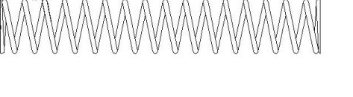
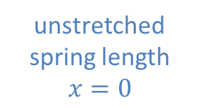


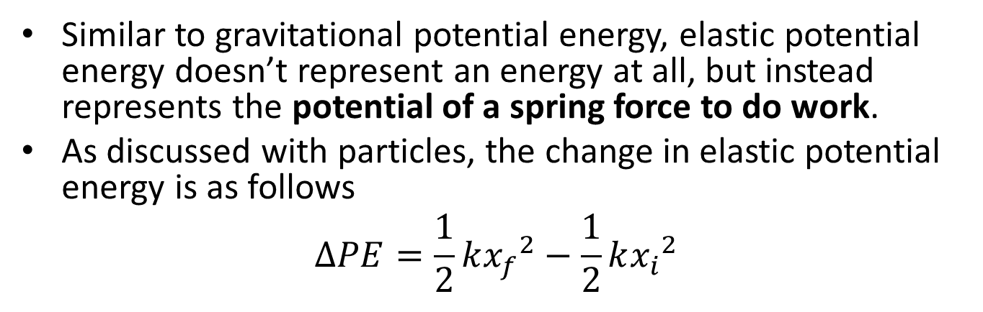


Linear Springs and Elastic Potential Energy
Similar to gravitational potential energy, elastic potential energy doesn’t represent an energy at all, but instead represents the potential of a spring force to do work.
As discussed with particles, the change in elastic potential energy is as follows
$$∆PE=\frac{1}{2}k{x_{f}}^{2}−\frac{1}{2}k{x_{i}}^{2}$$
unstretched spring length
$$x=0$$
$$x_{i}$$
$$F_{spring}$$
$$F_{spring}=kx$$
$$x_{f}$$

Slide 15
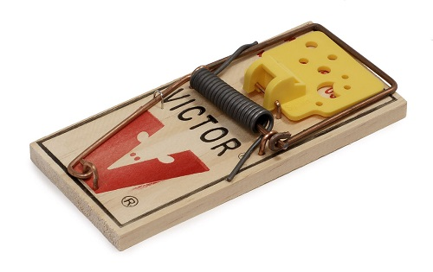
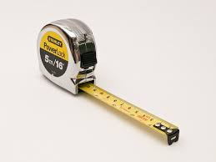
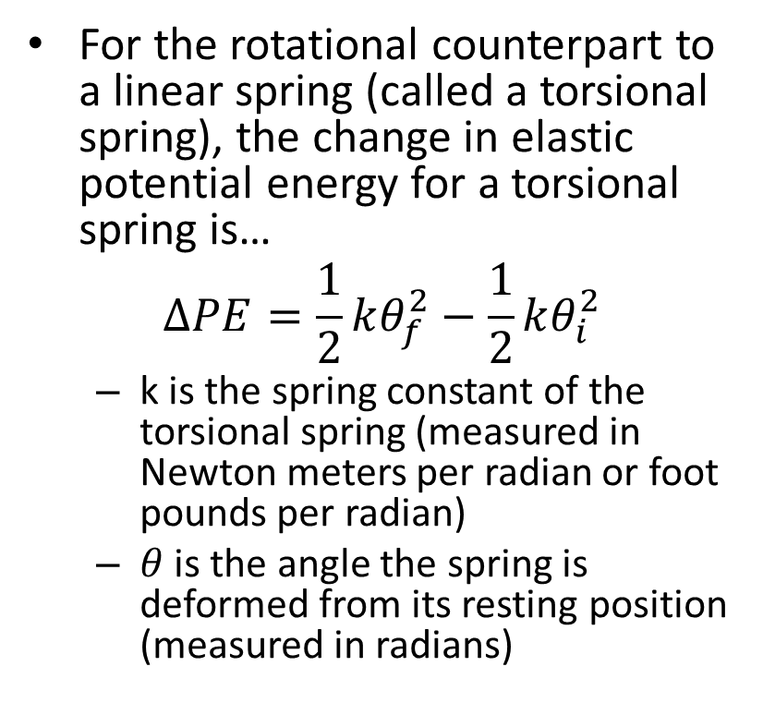
Torsional Springs
For the rotational counterpart to a linear spring (called a torsional spring), the change in elastic potential energy for a torsional spring is…
$$∆PE=\frac{1}{2}kθ_{f}^{2}−\frac{1}{2}kθ_{i}^{2}$$
k is the spring constant of the torsional spring (measured in Newton meters per radian or foot pounds per radian)
$θ$ is the angle the spring is deformed from its resting position (measured in radians)
Image by William Warby
CC-BY-SA 4.0

Slide 16
Thanks for Watching
See other engineering mechanics videos and access the full tool at…

Slide 17
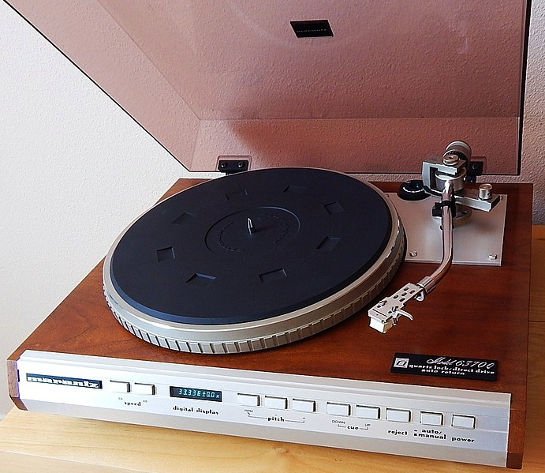
Worked Example
The turntable on a record player consists of a disk 12 in diameter with a weight of 5lbs. If the motor accelerates the turntable from rest to its operating speed of 33.33 rpm in one rotation.
Determine:
The work done by the motor.
The torque of the motor exerts.

Slide 18
Worked Example
A system as shown below is used to passively slow the lowering of a gate. The gate can be approximated as a flat plate on its edge with a mass of 25 kg and a height of 2m.
What would the angular velocity of the gate be without the spring?
If we want to reduce the angular velocity at the bottom to 25% of it’s original value what should the spring constant be? Assume the spring is upstretched as shown in the diagram.
1m
.7m
1m

Slide 19
Worked Example
A 5 kg spherical ball with a radius of .05m as shown below is placed on a ramp with an angle of 10º. If the ball rolls without slipping, what is the velocity of the ball at the bottom of the ramp?
.1 m

Slide 20
Worked Example
A 16 kg half cylinder is placed on a hard, flat surface as shown below and released from rest. What will the maximum angular velocity be as it rocks back and forth?
50 cm

Slide 21

Worked Example
A mechanism consists of 2, 3kg wheels connected to a 2kg bar as shown below. Based on the dimensions below, what is the minimum required initial velocity for the wheels to ensure the mechanism makes it all the way through one rotation without rocking backwards?
$$v_{i}=?$$
15 cm
15 cm

